Slide 1
Paul
HCI, Research & University

Slide 2
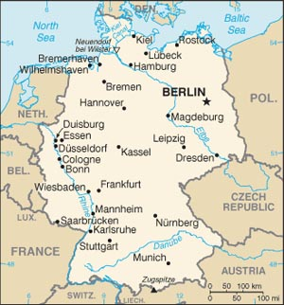
CV
Born & Grown up in Berlin, Germany
Finished Bachelor’s degree in Berlin
Problem with Bachelors (for me):
It’s only the basic CS knowledge and a (too) brief inside into interesting areas (stage 3)
Came to New Zealand to study (Masters)
Study fees cheap
Far away from home
Question was what to do for Masters/PhD
Networks
Operating Systems
HCI

Slide 3
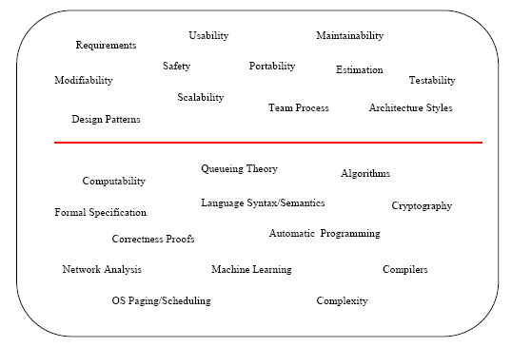
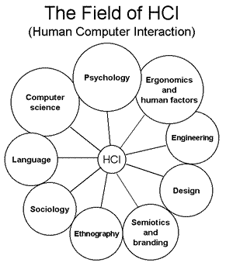
HCI - a multi-disciplinary field
. . .

Slide 4
Technology Trigger:
potential technology breakthrough kicks things off
Peak of Inflated Expectations:
There are number of success stories often accompanied by scores of failures
Trough of Disillusionment
Interest wanes as experiments and implementations fail to deliver.
Slope of Enlightenment
More instances of how the technology can benefit start to crystallize and become more widely understood
Plateau of Productivity:
Mainstream adoption starts to take off
Us/Me
YES the dot is dark blue ...
I have time!!!
http://www.gartner.com/technology/research/methodologies/hype-cycle.jsp

Slide 5
What is HCI (for me)
FUN
All the cool new tools
Nintendo WII, Eye-Tracking, Big Touch-Screens, Ipad, Mechanical Pen, Tablets PCs ... AND A HUGE LOCKS ON THE DOOR
Diversified
Can be practical; e.g. Evaluation studies
Can be theoretical; e.g. Recognition stuff
What it mainly is: Both ... And that’s what is nice about it
Collaborations
Everybody needs you because they know their stuff is awesome from their perspective but they don’t know whether it’s also awesome from a potential user’s perspective
Areas:
Everything which has an interface; e.g. Software
Doesn’t even need an software interface: e.g. Robotics

Slide 6
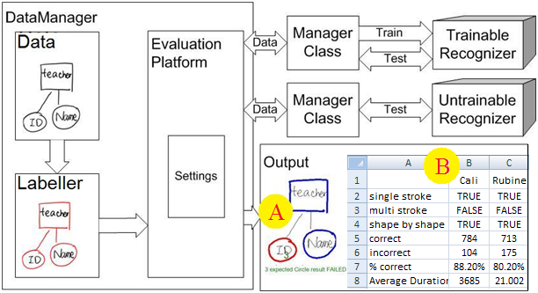
Master’s Degree (in a nutshell)
Sketch Recognition
Identify shapes that have been drawn with digital pen
I wrote a software to integrate recognition algorithms and evaluate them
Based on results of evaluation I wrote a new recognizer

Slide 7
Lessons Learned
One year sounds long but isn’t
Learned a lot things besides the obvious research things
Writing papers/publications
Organize yourself for a year
Conduction evaluation studies
Working with people/ in a team
Working together on big project/software toolkit
Conferences are fun … interesting .. like-minded people
Munich, Germany
Florida, USA
Vancouver, Canada
France
New Zealand

Slide 8
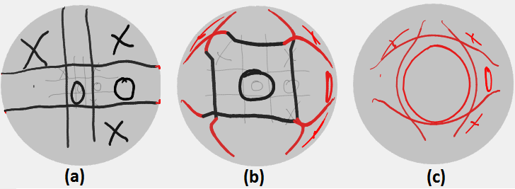
PhD
“Just” started
Try to make more of the limited space available on a display
Combine sketching with distortion techniques
Demo
Three different lenses showing a noughts and crosses game. Lens (a) is a magnifier. Lens (b) and (c) use a distorted transition region to generate the space required by the enlarged region. Lens (b) has a flat enlarged region while lens (c) has only a point at maximum magnification.

Slide 9
While doing each of my degrees I always said:
After this one university is OVER!! Need to work!!Real life here I come!!
But the reality is that I’m still here* …
* Thank you scholarships

